Slide 1

HOTEL MANAGEMENT SYSTEM
Travel

Slide 2
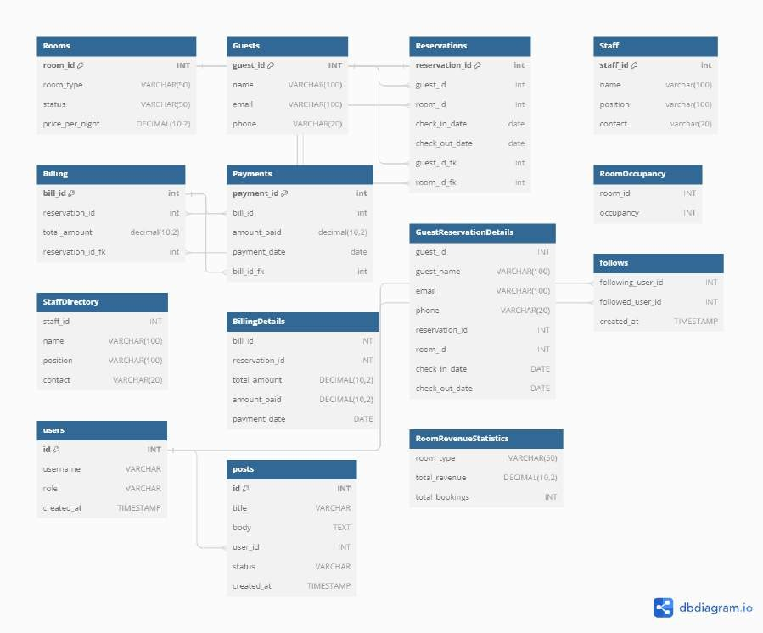
ER DIAGRAM

Slide 3

DATABASE CREATION AND SELECTION
S te p 1
Travel

Slide 4

CREATE DATABASE IF NOT EXISTS HOTEL MANAGEMENT SYSTEM; :THIS LINE CHECKS IF A DATABASE NAMED "HOTEL MANAGEMENT SYSTEM" EXISTS. IF NOT, IT CREATES IT.THIS IS USEFUL FOR ENSURING THAT THE DATABASE IS CREATED ONLY IF IT DOESN'T ALREADY EXIST, PREVENTING ERRORS IN CASE THE SCRIPT IS RUN MULTIPLE TIMES.
USE HOTEL MANAGEMENT SYSTEM THIS LINE SELECTS THE "HOTEL MANAGEMENT SYSTEM" DATABASE FOR SUBSEQUENT OPERATIONS, ENSURING THAT ALL FURTHER SQL STATEMENTS APPLY TO THIS SPECIFIC DATABASE.

Slide 5


TABLE CREATION
S t e p 2
Travel

Slide 6

ROOMS TABLE:THIS TABLE STORES INFORMATION ABOUT THE HOTEL'S ROOMS.
ROOM_ID INT PRIMARY KEY: DEFINES A UNIQUE IDENTIFIER FOR EACH ROOM.
ROOM_TYPE VARCHAR(50): REPRESENTS THE
TYPE OF ROOM (E.G., SINGLE, DOUBLE, SUITE).
STATUS VARCHAR(50): INDICATES THE CURRENT OCCUPANCY STATUS OF THE ROOM (E.G.,VACANT, OCCUPIED).
PRICE_PER_NIGHT DECIMAL(10, 2): STORES
THE PRICE PER NIGHT FOR EACH ROOM.

Slide 7

GUESTS TABLE:THIS TABLE HOLDS DETAILS
ABOUT THE HOTEL'S GUESTS.
GUEST_ID INT PRIMARY KEY: SERVES AS A UNIQUE IDENTIFIER FOR EACH GUEST.
NAME VARCHAR(100): STORES THE GUEST'S NAME.
EMAIL VARCHAR(100): STORES THE GUEST'S EMAIL ADDRESS.
PHONE VARCHAR(20): STORES THE
GUEST'S PHONE NUMBER.

Slide 8
RESERVATIONS TABLE:
THIS TABLE TRACKS RESERVATIONS MADE BY GUESTS.
RESERVATION_ID INT PRIMARY KEY: ACTS AS A UNIQUE IDENTIFIER FOR EACH RESERVATION.
GUEST_ID INT: REFERENCES THE GUEST WHO MADE THE RESERVATION.
ROOM_ID INT: REFERENCES THE ROOM RESERVED.
CHECK_IN_DATE DATE: STORES THE CHECK- IN DATE FOR THE RESERVATION.
CHECK_OUT_DATE DATE: STORES THE
CHECK-OUT DATE FOR THE RESERVATION.

Slide 9
STAFF TABLE:THIS TABLE CONTAINS INFORMATION ABOUT HOTEL STAFF. STAFF_ID INT PRIMARY KEY: SERVES AS A UNIQUE IDENTIFIER FOR EACH STAFF MEMBER.
NAME VARCHAR(100): STORES THE STAFF MEMBER'S NAME.
POSITION VARCHAR(100): SPECIFIES THE STAFF MEMBER'S POSITION OR ROLE WITHIN THE HOTEL.
CONTACT VARCHAR(20): STORES THE CONTACT INFORMATION FOR THE STAFF MEMBER.

Slide 10
BILLING TABLE:THIS TABLE RECORDS BILLING INFORMATION FOR RESERVATIONS.
BILL_ID INT PRIMARY KEY: ACTS AS A UNIQUE IDENTIFIER FOR EACH BILLING RECORD.
RESERVATION_ID INT: REFERENCES THE RESERVATION ASSOCIATED WITH THE BILL.
TOTAL_AMOUNT DECIMAL(10, 2): STORES THE TOTAL AMOUNT TO BE PAID FOR THE RESERVATION.

Slide 11
PAYMENTS TABLE:THIS TABLE TRACKS PAYMENTS MADE BY GUESTS.
PAYMENT_ID INT PRIMARY KEY: SERVES AS A UNIQUE IDENTIFIER FOR EACH PAYMENT.
BILL_ID INT: REFERENCES THE BILL ASSOCIATED WITH THE PAYMENT.
AMOUNT_PAID DECIMAL(10, 2): STORES THE AMOUNT PAID BY THE GUEST.
PAYMENT_DATE DATE: RECORDS THE DATE WHEN THE PAYMENT WAS MADE

Slide 12


VIEW CREATION
S t e p 3

Slide 13


GuestReservationDetails View: Combines data from the Guests and Reservations tables to provide details about guests and their reservations.
RoomOccupancy View: Calculates the occupancy status of each room based on reservation dates.
StaffDirectory View: Presents a list of staff members along with their positions and contact information.
BillingDetails View: Joins billing and payment information to provide a comprehensive view of billing details.
RoomRevenueStatistics View: Aggregates data from Rooms, Reservations, and Billing tables to generate statistics on room revenue and bookings.

Slide 14


INSERTING SAMPLE DATA:
Step 4

Slide 15

SAMPLE DATA IS INSERTED INTO EACH TABLE TO SIMULATE REAL-WORLD SCENARIOS AND FACILITATE TESTING AND DEVELOPMENT.
DATA INCLUDES INFORMATION ABOUT ROOMS, GUESTS, RESERVATIONS, STAFF, BILLING, AND PAYMENTS, ALLOWING FOR A COMPREHENSIVE EXPLORATION OF THE SYSTEM'S FUNCTIONALITIES.

Slide 16

HERE’S
THE CODE

Slide 17
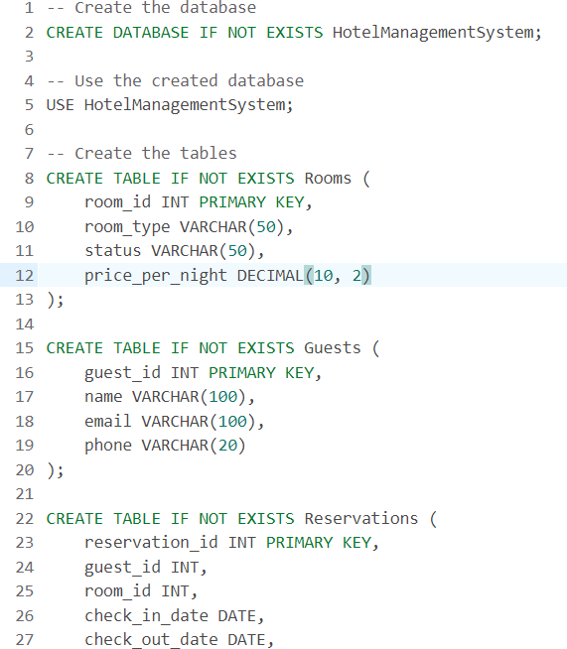
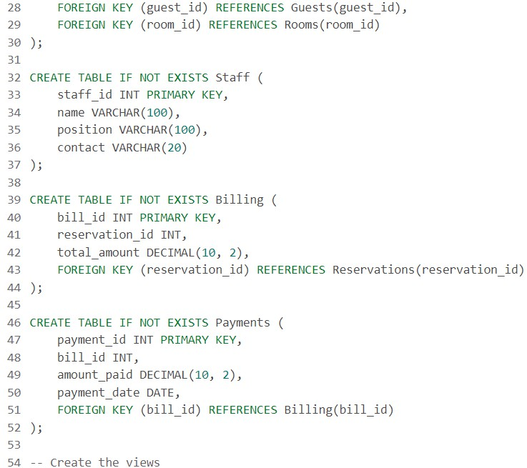
17
CODE

Slide 18
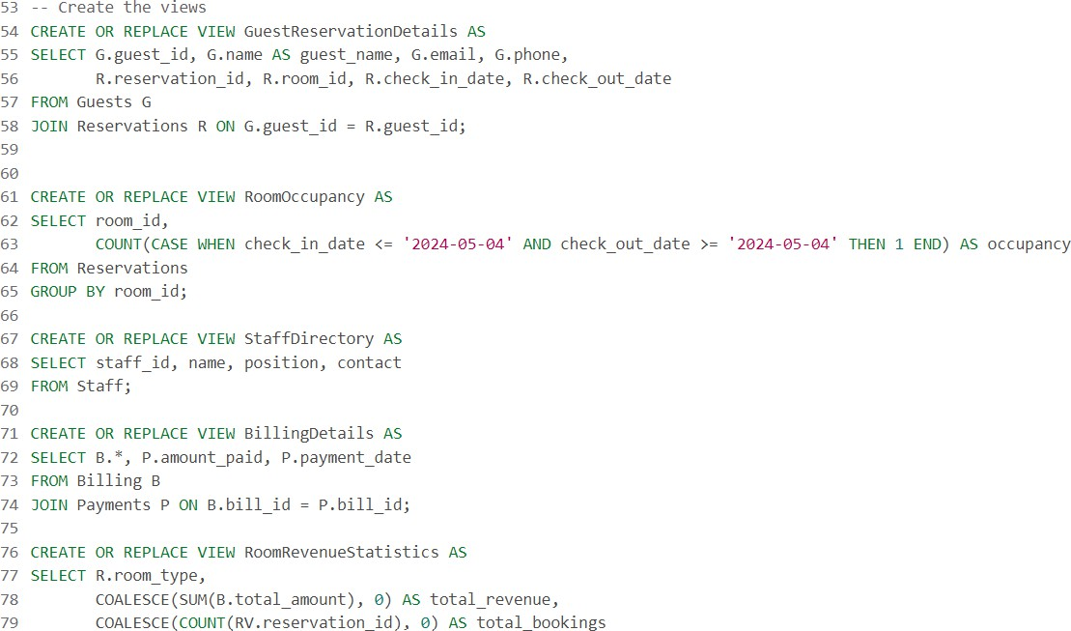
18
CODE

Slide 19
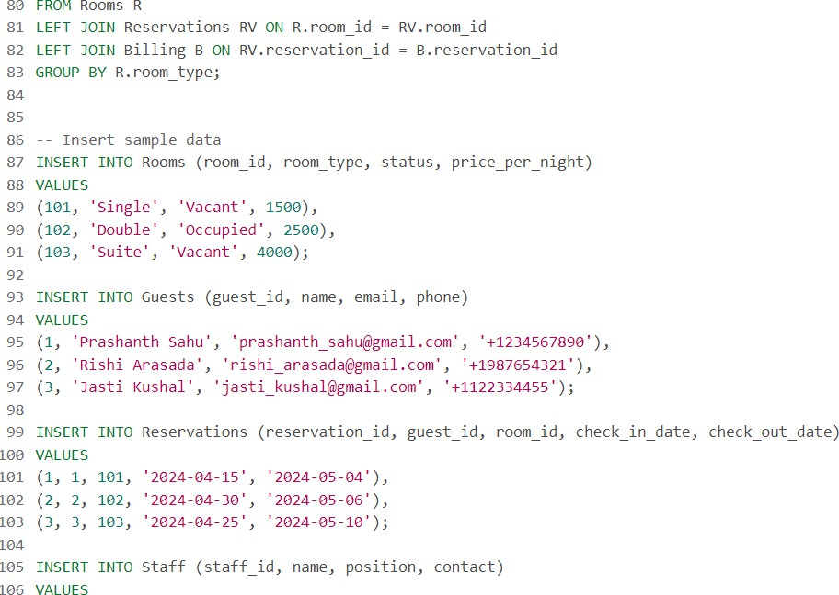
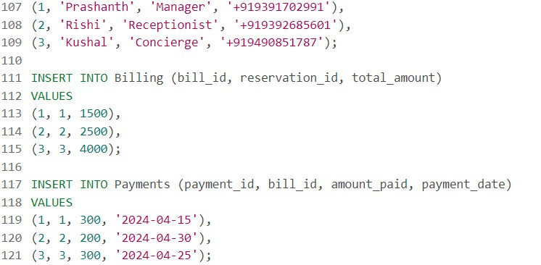
19
CODE

Slide 20
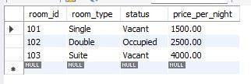
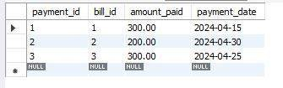
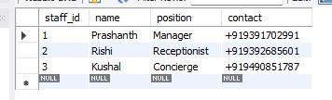
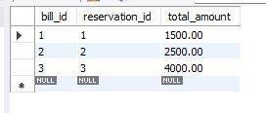
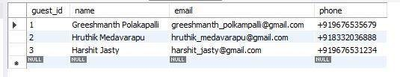
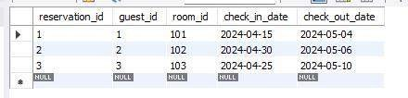

Slide 21

BY
RISHI
PRASHANTH
YOGI
KUSHAL
HOTEL MANAGEMENT

